Slide 1
Ontologies

Slide 2
Agenda
Introduction to semantic web
Ontology
RDF , RDFs ,OWL
Introduction to semantic web services
Very Brief MDA Introduction
Potential Uses of the Semantic Web in Systems and Software Engineering

Slide 3


Summarizing the Problem:
Computers don’t understand Meaning
“My mouse is broken. I need a new one…”

Slide 4


The Semantic Web Vision
“… the idea of having data on the Web defined and linked in a way that it can be used by machines not just for display purposes ,but for automation, integration and reuse of data across various applications”
http://www.w3.org/sw/
Notes:
הרעיון של הווב הסמנטי הוא שהנתונים בווב יוגדרו ויקושרו בצורה כזו שמחשבים יוכלו להשתמש בהם לא רק לצורכי הצגה אלא גם לאוטומציה אינטגרציה ושימוש חוזר בנתונים ע"י סוגים שונים של אפליקציות

Slide 5
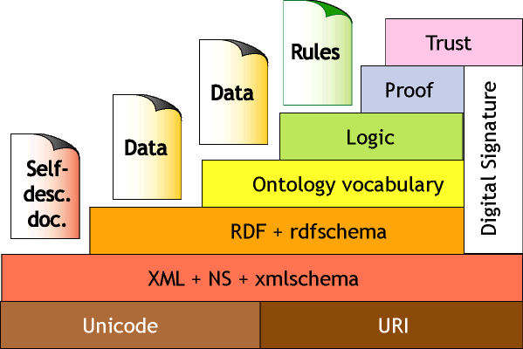
The Semantic Web
"The Semantic Web is an extension of the current web in which information is given well-defined meaning, better enabling computers and people to work in cooperation." -- Tim Berners-Lee
“the wedding cake”
Notes:
הווב הסמנטי הוא הרחבה של הווב הנוכחי שיאפשר למחשבים ואנשים לעבוד בשיתוף פעולה

Slide 6
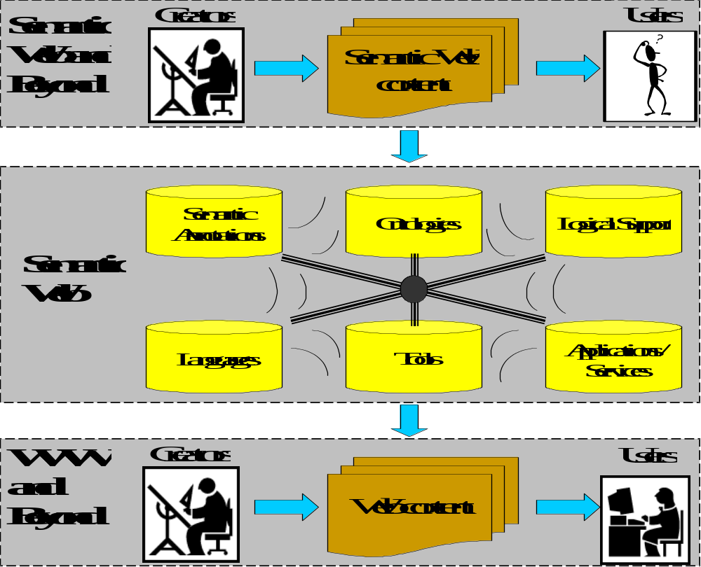
Semantic Web – New Users
applications
agents
Notes:
הריבוע התחתון מייצג את הווב לפני הווב הסמנטי . התוכן מוכנס לאתרים והמשתמש מדבר ישירות עם התוכן הלא מעובד.
השכבה האמצעית מציינת את הארגון של המידע בתוך הווב הסמנטי :ע"י שימוש בכלים שפות אונטולוגיות ועוד.
השכבה שלמעלה מראה שהמשתמשים כעת יכולים להיות גם אפליקציות
הווב הסמנטי יופעל על ידי סוכנים חכמים שיוכלו לעשות פעולות שדורשות הבנה.כמו שאנשים היום עושים
ה"סוכן " הוא הכוח האמיתי של הרשת הסמנטית.
משמעותו של הביטוי סוכן היא תכנה שמלקטת תכנים, מידע, ברשת ממקורות שונים מעבדת את האינפורמציה וחולקת אותו עם תוכנות אחרות הזקוקות לו.
סוכן שכזה שיגיע לאתר של מרפאה, למשל, ידע להתייחס לא רק למילים שהיום מוגדרות כמילות מפתח באינטרנט ושאותן יודע ומכיר, מתוכנת בשפת המחשב לזהות אותן. כמו למשל טיפול, תרופה, פיזיותרפיה, אלא גם את מילות הקישור :ד'ר X עובד, במרפאה, בימים, שני- שלישי, וכדו' ולפי הנ'ל יחזיר למשתמש ימי פגישות אפשריים בהתאמה למידע שנתן המשתמש ביחס ללו'ז שלו וכל זאת בלי להזדקק לתבונה מלאכותית של יצורים נוסח "מסע בין כוכבים".
אלא שהסמנטיקה, כלומר המילים ושימושיהם השונים, קודדו לדפי הרשת.

Slide 7
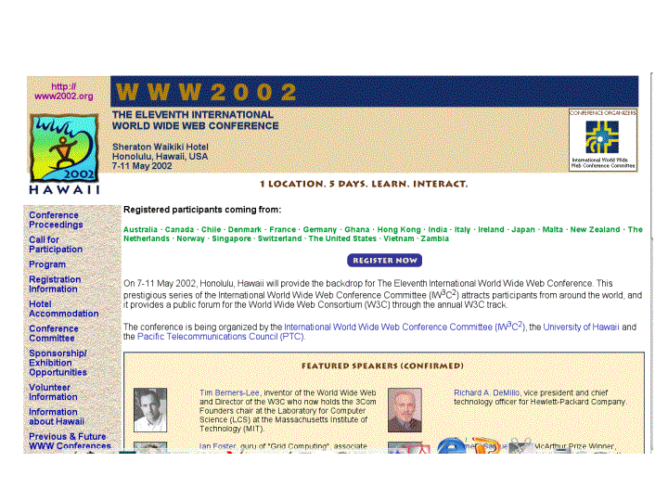
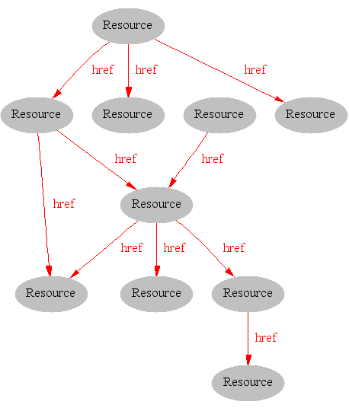
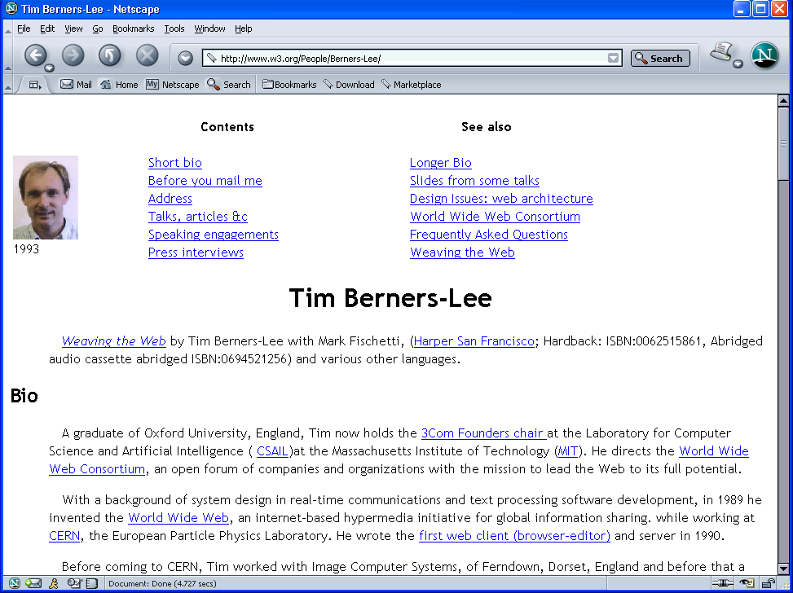
Where we are Today:
The Syntactic Web
[Hendler & Miller 02]
Notes:
הווב היום הוא בעיקר סינטקטי . המחשב מציג סינטקס ולא משמעות. דפי האינטרנט הם מקורות שמחוברים בינהם עי קישורים.

Slide 8
What information can we see…
WWW2002
The eleventh international world wide web conference
Sheraton waikiki hotel
Honolulu, hawaii, USA
7-11 may 2002
1 location 5 days learn interact
Registered participants coming from
australia, canada, chile denmark, france, germany, ghana, hong kong, india, ireland, italy, japan, malta, new zealand, the netherlands, norway, singapore, switzerland, the united kingdom, the united states, vietnam, zaire
Register now
On the 7th May Honolulu will provide the backdrop of the eleventh international world wide web conference. This prestigious event …
Speakers confirmed
Tim berners-lee
Tim is the well known inventor of the Web, …
Ian Foster
Ian is the pioneer of the Grid, the next generation internet …

Slide 9
Need to Add “Semantics”
Use Ontologies to specify meaning of annotations
  Ontologies provide a vocabulary of terms
  New terms can be formed by combining existing ones
  Meaning (semantics) of such terms is formally specified
  Can also specify relationships between terms in multiple ontologies

Slide 10
Ontology: Origins and History
Ontology in Philosophy
A philosophical discipline - a branch of philosophy that deals with the nature and the organisation of reality
Science of Being (Aristotle, Metaphysics, IV, 1)
Tries to answer the questions:
    What characterizes being?
    Eventually, what is being?

Slide 11
What Is An Ontology
What Is An Ontology
An ontology is an explicit description of a domain:
  concepts
  properties and attributes of concepts
  constraints on properties and attributes
  Individuals (often, but not always)
An ontology defines
  a common vocabulary
  a shared understanding

Slide 12
Ontology Examples
Taxonomies on the Web
  Yahoo! categories
Catalogs for on-line shopping
  Amazon.com product catalog
Domain-specific standard terminology
  Unified Medical Language System (UMLS)
  UNSPSC - terminology for products and services

Slide 13
What Is “Ontology Engineering”?
Ontology Engineering: Defining terms in the domain and relations among them
  Defining concepts in the domain (classes)
  Arranging the concepts in a hierarchy (subclass-superclass hierarchy)
  Defining which attributes and properties (slots) classes can have and constraints on their values
  Defining individuals and filling in slot values

Slide 14

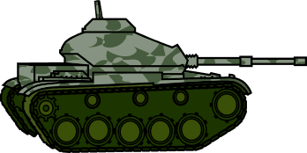
Ontology in Linguistics
Concept
Relates to
activates
Form
Referent
Stands for
“Tank“
?
[Ogden, Richards, 1923]
Notes:
אונתולוגיה בבלשנות
קיים איזשהו מונח , למונח הזה יש קונספציה לפי התפיסה אנו מחליטים לאיזה עצם במציאות אנחנו מתיחסים.

Slide 15
Ontology Definition
unambiguous terminology definitions
conceptual model of a domain (ontological theory)
Formal, explicit specification of a shared conceptualization
[Gruber93]
machine-readability with computational semantics
commonly accepted understanding
Notes:
הגדרה של אונתולוגיה:
מפרט רשמי וחד משמעי של הבנה תפיסתית משותפת

Slide 16
Ontology in Computer Science
An ontology is an engineering artifact:
  It is constituted by a specific vocabulary used to describe a certain reality, plus
  a set of explicit assumptions regarding the intended meaning of the vocabulary.
Thus, an ontology describes a formal specification of a certain domain:
  Shared understanding of a domain of interest
  Formal and machine manipulable model of a domain of interest
Notes:
אונתולגיה נוצרת על יד בני אדם באופן הנדסי.
מורכב מאוצר מילים ספציפי שנועד לתאר מציאות מסוימת
קבוצה של הנחות מפורשות הנוגעות למשמעות של אוצר המילים.
כלומר אונתולוגיה מתארת דומיין בצורה פורמאלית
הבנה משותפת של תחום עניין
פורמלי וניתן למניפולציה על ידי מכונה

Slide 17
Structure of an Ontology
Ontologies typically have two distinct components:
Names for important concepts in the domain
  Elephant is a concept whose members are a kind of animal
  Herbivore is a concept whose members are exactly those animals who eat only plants or parts of plants
  Adult_Elephant is a concept whose members are exactly those elephants whose age is greater than 20 years
Background knowledge/constraints on the domain
  Adult_Elephants weigh at least 2,000 kg
  All Elephants are either African_Elephants or Indian_Elephants
  No individual can be both a Herbivore and a Carnivore
Notes:
מבנה של אונתולגיה
לאונתולגיות יש שני מרכיבים ברורים:
שמות למושגים בתחום:
פיל, אוכל עשב, פיל בוגר
ידע מוקדם או אילוצים על התחום
פיל בוגר שוקל לפחות 2000
כל הפילים הם או פילים אפריקאיים או הודים
אין פרט שיכול להיות גם אוכל עשב וגם טורף.

Slide 18
Ontology Example
Concept
conceptual entity of the domain
Attribute
property of a concept
Relation
relationship between concepts or properties
Axiom
coherent description between Concepts / Properties / Relations via logical expressions
name
email
Person
student
nr.
research
field
isA – hierarchy (taxonomy)
Student
Professor
attends
holds
Lecture
lecture
nr.
topic
holds(Professor, Lecture) ⇒ Lecture.topic ∈ Professor.researchField

Slide 19
Ontology Elements
Concepts (classes) + their hierarchy
Concept properties (slots/attributes)
Property restrictions (type, cardinality, domain)
Relations between concepts (disjoint, equality)
Instances

Slide 20
How to build an ontology?
Steps:
  determine domain and scope
  enumerate important terms
  define classes and class hierarchies
  define slots
  define slot restrictions (cardinality, value-type

Slide 21
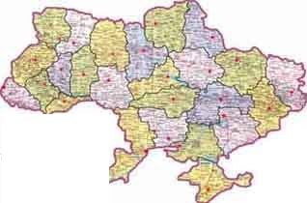
Step 1: Determine Domain and Scope
Domain: geography
Application: route planning agent
Possible questions:
Distance between two cities?
  What sort of connections exist between two cities?
  In which country is a city?
  How many borders are crossed?

Slide 22

Step 2: Enumerate Important Terms
city
capital
Connection_on_land
country
border
road
railway
Connection_on_water
currency
Connection_in_air
connection

Slide 23
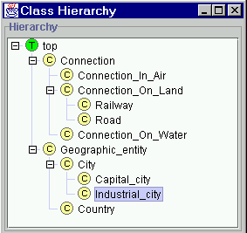
Step 3: Define Classes and Class Hierarchy

Slide 24
Step 4: Define Slots of Classes
Geographic_entity
End_point
Connection
Country
City
Start_point
Has_capital
Borders_with
Capital_of
Capital_city

Slide 25
Step 5: Define slot constraints
Slot-cardinality
  Ex: Borders_with multiple, Start_point single
Slot-value type
  Ex: Borders_with- Country

Slide 26
A Semantic Web — First Steps
Make web resources more accessible to automated processes
Extend existing rendering markup with semantic markup
  Metadata annotations that describe content/function of web accessible resources
Use Ontologies to provide vocabulary for annotations
  “Formal specification” is accessible to machines
A prerequisite is a standard web ontology language
  Need to agree common syntax before we can share semantics
  Syntactic web based on standards such as HTTP and HTML

Slide 27
Many languages use “object oriented” model based on:
Objects/Instances/Individuals
  Elements of the domain of discourse
  Equivalent to constants in FOL
Types/Classes/Concepts
  Sets of objects sharing certain characteristics
  Equivalent to unary predicates in FOL
Relations/Properties/Roles
  Sets of pairs (tuples) of objects
  Equivalent to binary predicates in FOL
Such languages are/can be:
  Well understood
  Formally specified
  (Relatively) easy to use
  Amenable to machine processing

Slide 28
RDF and RDFS
RDF stands for
Resource Description Framework
is a W3C standard, which provides tool to describe Web resources
provides interoperability between applications that exchange machine-understandable information

Slide 29
RDF and RDFS
RDFS extends RDF with “schema vocabulary”, e.g.:
  Class, Property
  type, subClassOf, subPropertyOf
  range, domain

Slide 30
The RDF Data Model
Statements are
<subject, predicate, object> triples:
  <Ian,hasColleague,Uli>
Can be represented as a graph:
Ian
hasColleague
Uli
Statements describe properties of resources
A resource is any object that can be pointed to by a URI:
  a document, a picture, a paragraph on the Web;
  http://www.cs.man.ac.uk/index.html
  isbn://5031-4444-3333
  …
Properties themselves are also resources (URIs)

Slide 31
Linking Statements
The subject of one statement can be the object of another
Such collections of statements form a directed, labelled graph
Note that the object of a triple can also be a “literal” (a string)
Ian
hasColleague
Uli
hasHomePage
hasColleague
Carole
http://www.cs.mam.ac.uk/~sattler

Slide 32
RDF Syntax
Subject of an RDF statement is a resource
Predicate of an RDF statement is a property of a resource
Object of an RDF statement is the value of a property of a resource

Slide 33
RDF Example
Ora Lassila is the creator of the resource http://www.w3.org/Home/Lassila
<rdf:RDF>
<rdf:Description about=
"http://www.w3.org/Home/Lassila">
<s:Creator>Ora Lassila</s:Creator>
</rdf:Description>
</rdf:RDF>

Slide 34
RDF Schema (RDFS)
RDF gives a formalism for meta data annotation, and a way to write it down in XML, but it does not give any special meaning to vocabulary such as subClassOf or type
  Interpretation is an arbitrary binary relation

Slide 35
RDF Schema (RDFS)
RDF Schema allows you to define vocabulary terms and the relations between those terms
  it gives “extra meaning” to particular RDF predicates and resources
  this “extra meaning”, or semantics, specifies how a term should be interpreted

Slide 36
RDFS Examples
RDF Schema terms (just a few examples):
  Class
  Property
  type
  subClassOf
  range
  domain
These terms are the RDF Schema building blocks (constructors) used to create vocabularies:
  <Person,type,Class>
  <hasColleague,type,Property>
  <Professor,subClassOf,Person>
  <Carole,type,Professor>
  <hasColleague,range,Person>
  <hasColleague,domain,Person>

Slide 37
From RDF to OWL
OWL is a language for defining Web Ontologies and their associated Knowledge Bases
The OWL language is a revision of the DAML+OIL web ontology language incorporating learning from the design and application use of DAML+OIL.

Slide 38
OWL became standard
10 February 2004 the World Wide Web Consortium announced final approval of two key Semantic Web technologies, the revised Resource Description Framework (RDF) and the Web Ontology Language (OWL).

Slide 39
OWL Example
There are two types of animals, Male and Female.
<rdfs:Class rdf:ID="Male">
<rdfs:subClassOf rdf:resource="#Animal"/>
</rdfs:Class>
The subClassOf element asserts that its subject - Male - is a subclass of its object -- the resource identified by #Animal.
<rdfs:Class rdf:ID="Female">
<rdfs:subClassOf rdf:resource="#Animal"/>
<owl:disjointWith rdf:resource="#Male"/>
</rdfs:Class>
Some animals are Female, too, but nothing can be both Male and Female (in this ontology) because these two classes are disjoint (using the disjointWith tag).

Slide 40
OWL Example in Protégé (1)
Class
  Person superclass
  Man, Woman subclasses
Properties
  isWifeOf, isHusbandOf
Property characteristics, restrictions
  inverseOf
  domain
  range
  Cardinality
Class expressions
  disjointWith

Slide 41
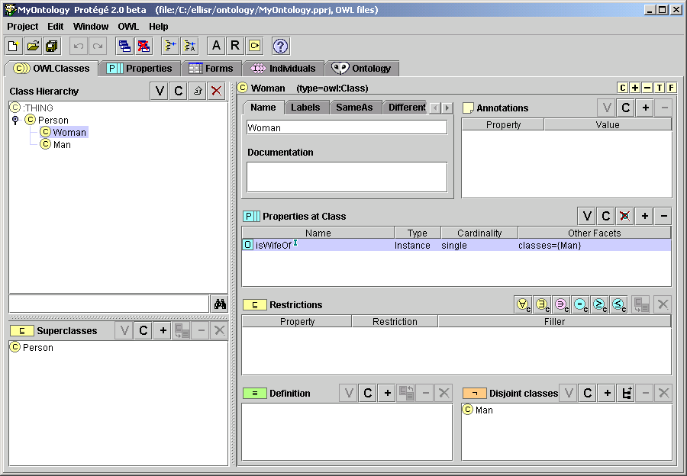
OWL Example in Protégé (2)

Slide 42
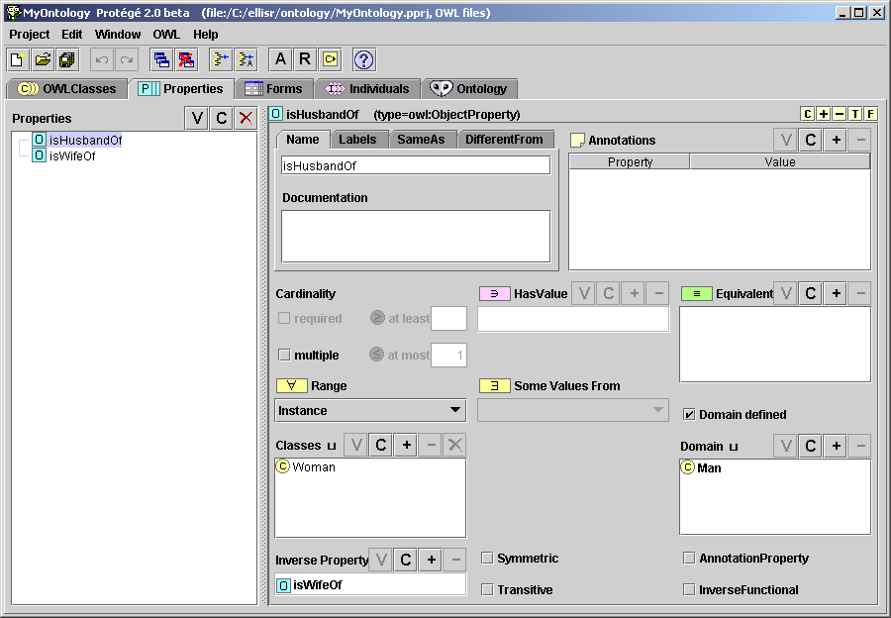
OWL Example in Protégé (3)

Slide 43
Ontology-development tools
Ontology-development tools
Protégé
OntoEdit
OilEd
Chimaera
…

Slide 44
Ontology-development environments - Protégé
Extensible platform (plug-ins)
Semantic Web: OWL, DAML+OIL, OIL, …
Import/Export: OKBC Tab Widget, XML, TX
RuleML Tab Widget, …
Inference & Reasoning: Jess Tab, Algernon
Tab, CLISP Tab, …
Software engineering: UML Storage Backend,
XMI Storage Backend, …

Slide 45
What lack ontology building tools?
Shortcomings
  Ontologies – built on AI concepts
  Tools and languages don’t use the same terminology
  Software practitioners don’t know all these ontology concepts
    They need more familiar notation and tools
    They need a unified representation for ontologies
UML as a natural solution

Slide 46
The Robber and the Speeder
On the next few slides is an example that shows how an OWL Ontology provides the necessary information to link a robber and a speeder.

Slide 47
An OWL Ontology can be used to answer questions that are implicit in your data
4
How many
guns/people
are registered
in a gun
license?
1
How many guns can have this serial
number?
<GunLicense>
<registeredGun>
<Gun>
<serial>ABCD</serial>
</Gun>
</registeredGun>
<holder>
<Person>
<driversLicenseNumber>ZXYZXY</driversLicenseNumber>
</Person>
</holder>
</GunLicense>
2
How many people can have
this driver's license number?
3
Can this gun
be registered
in other gun
licenses?

Slide 48
The OWL Gun License Ontology answers the questions!
4
A gun license
registers one
gun to one
person.
1
Only one gun can have this
serial number.
<GunLicense>
<registeredGun>
<Gun>
<serial>ABCD</serial>
</Gun>
</registeredGun>
<holder>
<Person>
<driversLicenseNumber>ZXYZXY</driversLicenseNumber>
</Person>
</holder>
</GunLicense>
2
Only one person can have this
driver's license number.
3
A gun can be
registered in
only one gun
license.

Slide 49
Robber drops gun while fleeing!
First of all a robbery takes place. The robber drops his gun
While fleeing. This report is filed by the investigating officers:
<RobberyEvent>
<date>...</date>
<description>...</description>
<evidence>
<Gun>
<serial>ABCD</serial>
</Gun>
</evidence>
<robber>
<Person /> <!-- an unknown person -->
</robber>
</RobberyEvent>

Slide 50
Speeder stopped
Subsequently a car is pulled over for speeding. The traffic
Officer files this report electronically while issuing a ticket:
<SpeedingOffence>
<date>...</date>
<description>...</description>
<speeder>
<Person>
<name>Fred Blogs</name>
<driversLicenseNumber>ZXYZXY</driversLicenseNumber>
</Person>
</speeder>
</SpeedingOffence>

Slide 51
The speeder owns a gun with the same serial number as the robbery gun!
At police headquarters (HQ), a computer analyzes each report
as it is filed. The computer uses the driver's license information
to look up any other records it has about Fred Blogs
(the speeder) and discovers this gun license:
<GunLicense>
<registeredGun>
<Gun>
<serial>ABCD</serial>
</Gun>
</registeredGun>
<holder>
<Person>
<driversLicenseNumber>ZXYZXY</driversLicenseNumber>
</Person>
</holder>
</GunLicense>

Slide 52
Case Solved?
Not yet! These questions must be answered before the speeder can be arrested as the robbery suspect:
  Can multiple guns have the same serial number?
    If so, then just because Fred Blogs owns a gun with the same serial number as the robbery gun does not mean it was his gun that was used in the robbery.
  Can multiple people have the same driver's license number?
    If so, then the gun license information may be for someone else.
  Can a gun be registered in multiple gun licenses?
    If so, then the other gun licenses may show the holder of the gun to be someone other than Fred Blogs.
  Can a gun license have multiple holders of a registered gun?
    If so, then there may be another gun license document (not available at the police HQ) which shows the same registered gun but with a different holder.
The OWL Gun License Ontology provides the information needed to answer these questions!
1
2
3
4

Slide 53
Can multiple guns have the same serial number?
This OWL statement tells the computer at police HQ that each
Gun is uniquely identified by its serial number:
<owl:InverseFunctionalProperty rdf:ID="serial">
<rdfs:domain rdf:resource="Gun"/>
<rdfs:range
rdf:resource="http://www.w3.org/2000/01/rdf-schema#Literal"/>
</owl:InverseFunctionalProperty>
1
Only one gun can have this serial number.
<Gun>
<serial>ABCD</serial>
</Gun>

Slide 54
Can multiple people have the same driver's license number?
The following OWL statement tells the computer that a driver's
license number is unique to a Person:
<owl:InverseFunctionalProperty rdf:ID="driversLicenseNumber">
<rdfs:domain rdf:resource="Person"/>
<rdfs:range
rdf:resource="http://www.w3.org/2000/01/rdf-schema#Literal"/>
</owl:InverseFunctionalProperty>
2
Only one person can have this
driver's license number.
<Person>
<driversLicenseNumber>ZXYZXY</driversLicenseNumber>
</Person>

Slide 55
Can a gun be registered in multiple gun licenses?
The next OWL statement tells the computer that the
registeredGun property uniquely identifies a GunLicense,
i.e., each gun is associated with only a single GunLicense:
<owl:InverseFunctionalProperty rdf:ID="registeredGun">
<rdfs:domain rdf:resource="GunLicense"/>
<rdfs:range rdf:resource="Gun"/>
</owl:InverseFunctionalProperty>
<GunLicense>
<registeredGun>
<Gun>
<serial>ABCD</serial>
</Gun>
</registeredGun>
...
</GunLicense>
3
A gun can be
registered in
only one gun
license.

Slide 56
Can a gun license have multiple holders of a registered gun?
The police computer uses the following OWL statement to
determine that the gun on the license is the same gun used
in the robbery. This final statement seals the speeder's fate.
It tells the computer that each GunLicense applies to only
one gun and one person. So, there is no doubt that the
speeder is the person who owns the gun
<owl:Class rdf:ID="GunLicense">
<owl:intersectionOf rdf:parseType="Collection">
<owl:Restriction>
<owl:onProperty rdf:resource="#registeredGun"/>
<owl:cardinality>1</owl:cardinality>
</owl:Restriction>
<owl:Restriction>
<owl:onProperty rdf:resource="#holder"/>
<owl:cardinality>1</owl:cardinality>
</owl:Restriction>
</owl:intersectionOf>
</owl:Class>
4
A gun license
registers one
gun to one
person.
<GunLicense>
<registeredGun>
...
<holder>
...
</GunLicense>

Slide 57
Summary of the example
An OWL Ontology provides additional information about your data.
  Example: The Gun License Ontology provided the data needed for the police computer to link the Robber and the Speeder!
OWL is intended to be used when processing Web documents. Thus, OWL enables an ad-hoc exploitation of Web documents, i.e., the Semantic Web!

Slide 58






Semantic Web and Web Services – The Vision
500 million user
more than 3 billion pages
Static
WWW
URI, HTML, HTTP

Slide 59
Semantic Web and Web Services
  Serious Problems in
  information finding,
  information extracting,
  Information representing,
  information interpreting and information maintaining.
WWW
URI, HTML, HTTP
Semantic Web
RDF, RDF(S), OWL
Static

Slide 60
Semantic Web and Web Services – The Vision
Web Services
UDDI, WSDL, SOAP
Dynamic
  Bringing the computer back as a device for computation
WWW
URI, HTML, HTTP
Semantic Web
RDF, RDF(S), OWL
Static

Slide 61
Semantic Web and Web Services – The Vision
  Bringing the Web to its full potential
Web Services
UDDI, WSDL, SOAP
Intelligent Web
Services
Dynamic
WWW
URI, HTML, HTTP
Semantic Web
RDF, RDF(S), OWL
Static

Slide 62
Web Services
Web Services [Stencil Group]
loosely coupled, reusable components
encapsulate discrete functionality
distributed
programmatically accessible over standard internet protocols
add new level of functionality on top of the current web

Slide 63
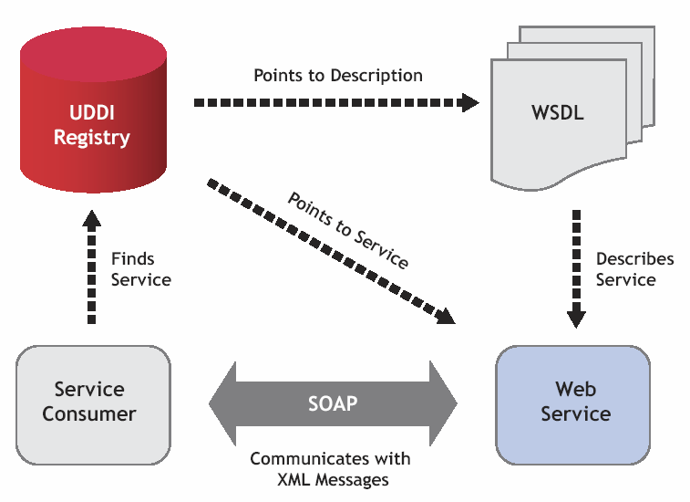
Using Web Services

Slide 64

Using Web Services
Syntax Only

Slide 65
Lack of SWS standards
Current technology does not allow realization of any of the parts of the Web Service usage process:
  Only syntactical standards available
  Lack of fully developed semantic markup languages
  Lack of semantically marked up content and services
  Lack of semantically enhanced repositories
  Lack of frameworks that facilitate discovery, composition and execution
  Lack of tools and platforms that allow to semantically enrich current Web content

Slide 66
Semantic Web Services
Define exhaustive description frameworks for describing Web Services and related aspects
(Web Service Description Ontologies)
Support ontologies as underlying data model to allow machine supported data interpretation
(Semantic Web aspect)
Define semantically driven technologies for automation of the Web Service usage process
(Web Service aspect)

Slide 67
Semantic Web Services (2)
Usage Process:
Publication: Make available the description of the capabilities of a service
Discovery: Locate different services suitable for a given task
Selection: Choose the most appropriate services among the available ones
Composition: Combine services to achieve a goal
Mediation: Solve mismatches (in data or process) among the combined services
Execution: Invoke services following programmatic conventions

Slide 68
Semantic Web Services (3)
Usage Process – execution support
Monitoring: Control the execution process
Compensation: Provide transactional support and undo or mitigate unwanted effects
Replacement: Facilitate the substitution of services by equivalent ones
Auditing: Verify that service execution occurred in the expected way

Slide 69
Summary Semantic Web Services
Semantic Web Services
=
Semantic Web Technology
+
Web Service Technology

Slide 70
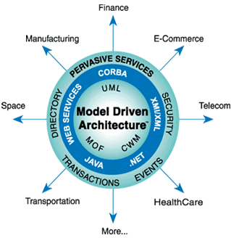
Model Driven Architecture® (MDA®)
Insulates business applications from technology evolution, for
  Increased portability and platform independence
  Cross-platform interoperability
  Domain-relevant specificity
Consists of standards and best practices across a range of software engineering disciplines
  The Unified Modeling Language (UML®)
  The Meta-Object Facility (MOF™)
  The Common Warehouse Metamodel (CWM™)

Slide 71
Model Driven Architecture® (MDA®)
MOF defines the metadata architecture for MDA
  Database schema, UML and ER models, business and manufacturing process models, business rules, API definitions, configuration and deployment descriptors, etc.
  Supports automation of physical management and integration of enterprise metadata
  MOF models of metadata are called metamodels

